Slide 1
Using LinkedIn Learning as a Teaching Resource
Teaching & Learning Month, MacPherson Institute
May 17, 2021
Presenter: Jeannie An, Research Services Librarian
Notes:
This is a high-level overview of LiL and why LiL can be used as an effective Teaching Resource
The mechanics and how to use LiL will be available at a later date (how to create collections, curated lists, share content with students)
If there is enough interest, I can also provide customized LiL training session(s)
My contact details will be provided at the end of the presentation

Slide 2
Agenda
Brief Introduction
Poll #1
What is LinkedIn Learning (LiL) and what it isn’t
Why use LiL
Strategies for Successful integrating LiL into your classroom environment
Upcoming LiL session(s) specific for instructors

Slide 3
Poll Questions – answer in the chat
1. Have you used LinkedIn Learning (or Lynda.com) while you have been at McMaster?
2. What faculty or department are affiliated with?
Please submit answers in the chat.
Notes:
Spend about a minute or two on this.

Slide 4
What is LinkedIn Learning (LiL)?
LinkedIn Learning is a video-based training library where users can access online learning modules to build specific skills and achieve personal and professional goals.
Benefits of LiL include:
Just-in-time training, to supplement in-class courses
Over 13,000 online modules (courses, videos, podcasts, blogs, and more) including learning software, IT, business skills and digital literacy skills
Taught by experts in their fields who are passionate about teaching
View from a computer, tablet, or mobile device
Self-paced and self-directed learning

Slide 5
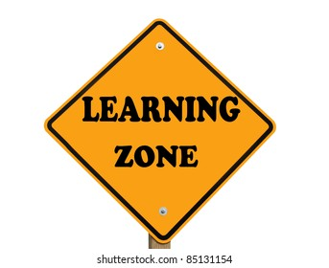
What LiL is not
A substitute for a lecture; you are the subject expert; you create discussion from the LiL topics you select for your students
A resource to replace your content
A live webcast; it asynchronous; students can view the recordings at their own pace and review over as needed

Slide 6
Importance of LiL in higher education
ALA (American Library Association) definition of Digital Literacy:
Ability to use information and communication technologies to find, evaluate, create and communicate information
Basic digital fluency skills:
Navigate a website
Create a spreadsheet
Quickly learn a new skills online or to share digital resources
Notes:
In the digital age we have access to more technology than ever and understanding how to utilize this technology is an important skill for students.
ALA (American Library Association)
Defines Digital Literacy as the Ability to use information and communication technologies to find, evaluate, create and communicate information
In order for students to be successful learners they need to understand technology and how to use it effectively, efficiently and ethically. Instructors need to help students develop the ability, or skills to communicate and collaborate using online using tools such as email, forums, social media or video conferencing resources e.g. Zoom or Teams
In the online environment, students need to understand what measures to take to protect their information, including privacy settings, passwords, and an understanding of cloud-based storage. Digital Literacy also includes the sub-topic of Digital Citizenship, how to properly use social media tools for discussion and also respect other people’s privacy and ideas. (e.g. citing sources properly).

Slide 7
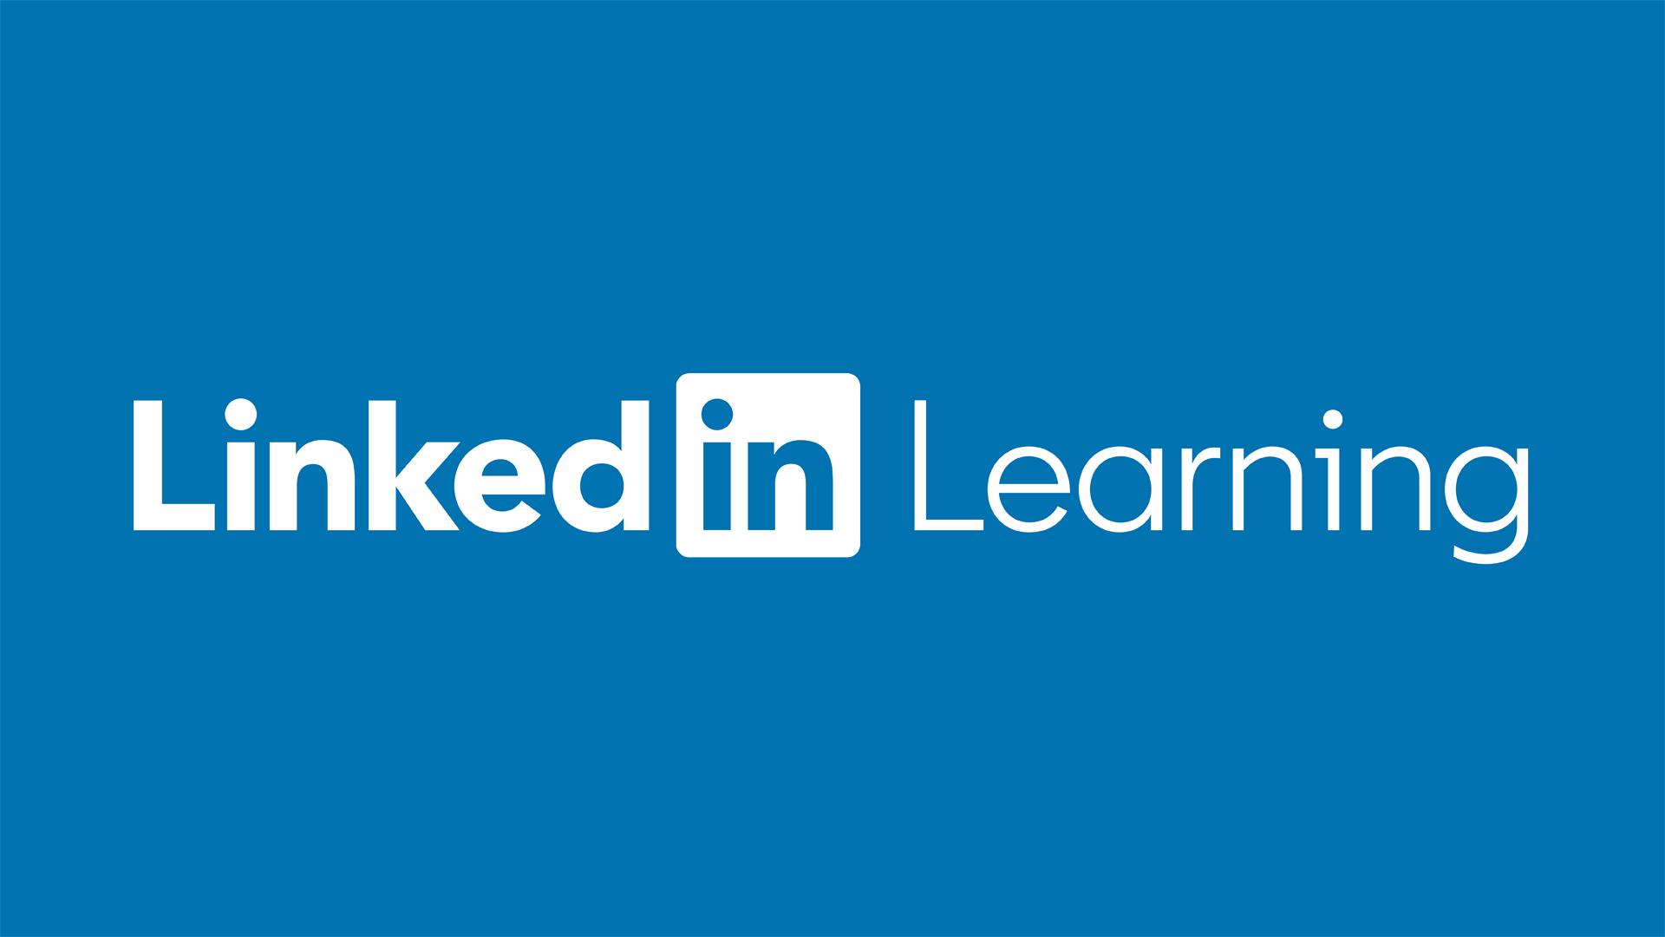
Some LiL content that support Digital Literacy and Technology
Information Literacy (1h 47min)
Building Digital Literacy Skills (2m 24sec)
Introduce Digital Literacy to your Class (2m 39sec)
What is Digital Citizenship? (1m 17sec)
Digital Media Foundations (2h 14min)
Video Editing (4m 40sec)
The Importance of Audio (4m 56sec)
Web Programming Foundations (58 min)
Notes:
The LinkedIn Learning Library has specific courses that teach these skills on topics such as digital citizenship, information literacy and digital medial foundations. LiL also provides access to courses where students can learn about new technologies related to topics such as video editing, audio editing, web development and more.

Slide 8
Strategies to incorporate LiL into the classroom
In your syllabus or course outline, list the programs, technology and skills student need to complete the course
Link to LiL content relevant to the required technology or skill (e.g. Excel) so students can learn on their own, if needed (self-directed learning)
Create assignments, where students can showcase their understanding of a topic using a digital media resource e.g. creating an executive power point presentation, website, or blog
Notes:
If you are providing an assignment using digital media, ensure you communicate your expectations using clearly defined rubrics
Encourage students to make coursework high enough quality they can use these projects in portfolios that might help them when seeking employment

Slide 9
Strategies continued
Think of non-technical skills, or soft skills, students will need to complete their assignments
Link to relevant soft-skills LiL Content:
Communication Foundations
Working in Teams / Collaboration
Effective Listening
Information Literacy Skills

Slide 10
Where do I begin?
LinkedIn Learning for Faculty and Instructors:
Curated list of course and videos to get you started using LiL as an instructor
Importance of Self-care and Healthy Wellness
Healthy Wellness Recommendations for McMaster
collection of courses to support healthy wellness
LinkedIn Learning Login Page:
Use your MAC ID to login
Email: linkedin@mcmaster.ca

Slide 11
Upcoming LiL Events
LinkedIn Learning May Challenge: Mindset Matters
Monthly challenge in May focuses on the power of positive thinking and how to foster a growth mindset. Each day, spend less than 5 minutes to keep and stay positive!
For more information on LiL or to book a personalized LiL consultation, contact Jeannie An, McMaster LinkedIn Learning Campus Coordinator: anjean@mcmaster.ca or email: linkedin@mcmaster.ca
If you need assistance with using LiL as a pedagogy tool, please contact MacPherson Institute on ways to incorporate LiL content into your course.

Slide 12
Thank you

