Slide 1

What is a pencil?
A definition:
A pencil (/ˈpɛnsəl/ ⓘ) is a writing or drawing implement with a solid pigment core in a protective casing that reduces the risk of core breakage and keeps it from marking the user's hand.
Most pencil cores are made of graphite powder mixed with a clay binder. Graphite pencils (traditionally known as "lead pencils") produce grey or black marks that are easily erased, but otherwise resistant to moisture, most solvents, ultraviolet radiation and natural aging. Other types of pencil cores, such as those of charcoal, are mainly used for drawing and sketching. Coloured pencils are sometimes used by teachers or editors to correct submitted texts, but are typically regarded as art supplies, especially those with cores made from wax-based binders that tend to smear when erasers are applied to them. Grease pencils have a softer, oily core that can leave marks on smooth surfaces such as glass or porcelain.
The most common pencil casing is thin wood, usually hexagonal in section, but sometimes cylindrical or triangular, permanently bonded to the core. Casings may be of other materials, such as plastic or paper. To use the pencil, the casing must be carved or peeled off to expose the working end of the core as a sharp point. Mechanical pencils have more elaborate casings which are not bonded to the core; instead, they support separate, mobile pigment cores that can be extended or retracted (usually through the casing's tip) as needed. These casings can be reloaded with new cores (usually graphite) as the previous ones are exhausted.
Pencils create marks by physical abrasion, leaving a trail of solid core material that adheres to a sheet of paper or other surface. They are distinct from pens, which dispense liquid or gel ink onto the marked surface.
Content source: https://en.wikipedia.org/wiki/Pencil
Image: https://www.bbc.com/news/business-48383050
Notes:
In this slide the learner would have to interpret the image, the text, and the underlined content (links). The link symbol tells the learner there is more information and so they may be enticed to click on this even though it has little relevance.
The contrast with the text/image is a challenge and the user will have to work to read easily.
There is a lot of information on one slide.

Slide 2
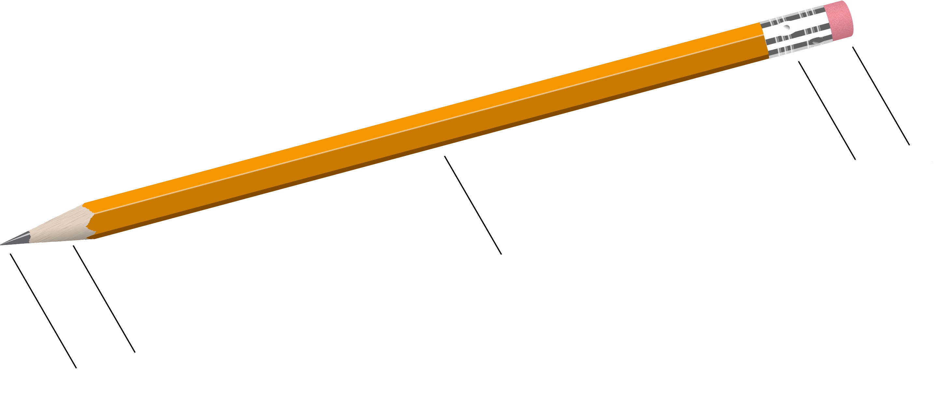
What is a pencil?
Eraser
Ferrule
Hexagonal design
Cylinder wood body
Graphite Core
Learn More:
Image Source: https://en.wikipedia.org/wiki/Pencil
Notes:
This design minimizes content, focuses the learners attention. Additional opportunities for simplification are possible by animating labels. The design is also more visual but includes a connection to learn more in an alternative format, increasing the accessibility of the topic for different types of learners.

